Slide 1
HTML
Day 2

Slide 2
Feedback from you! go.meet.sh/feedback1

Slide 3
Kahoot! Quiz

Slide 4
Yesterday class
Intro HTML
Basic tags & attributes

Slide 5
Today overview
Tables
Lists
Forms
Div & page layout

Slide 6
Tables

Slide 7
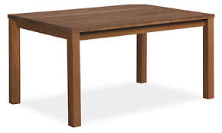
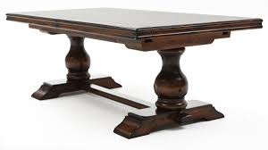
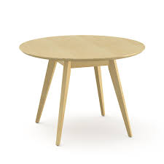
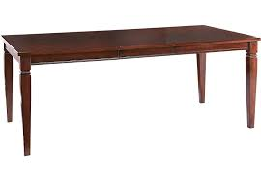
Tables?

Slide 8
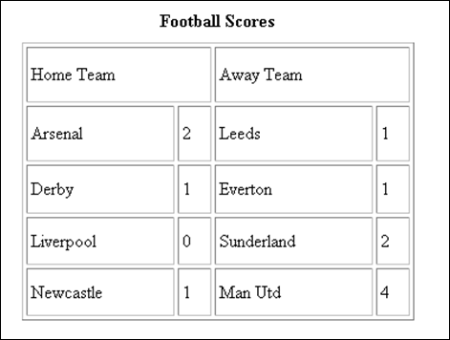
HTML Table

Slide 9
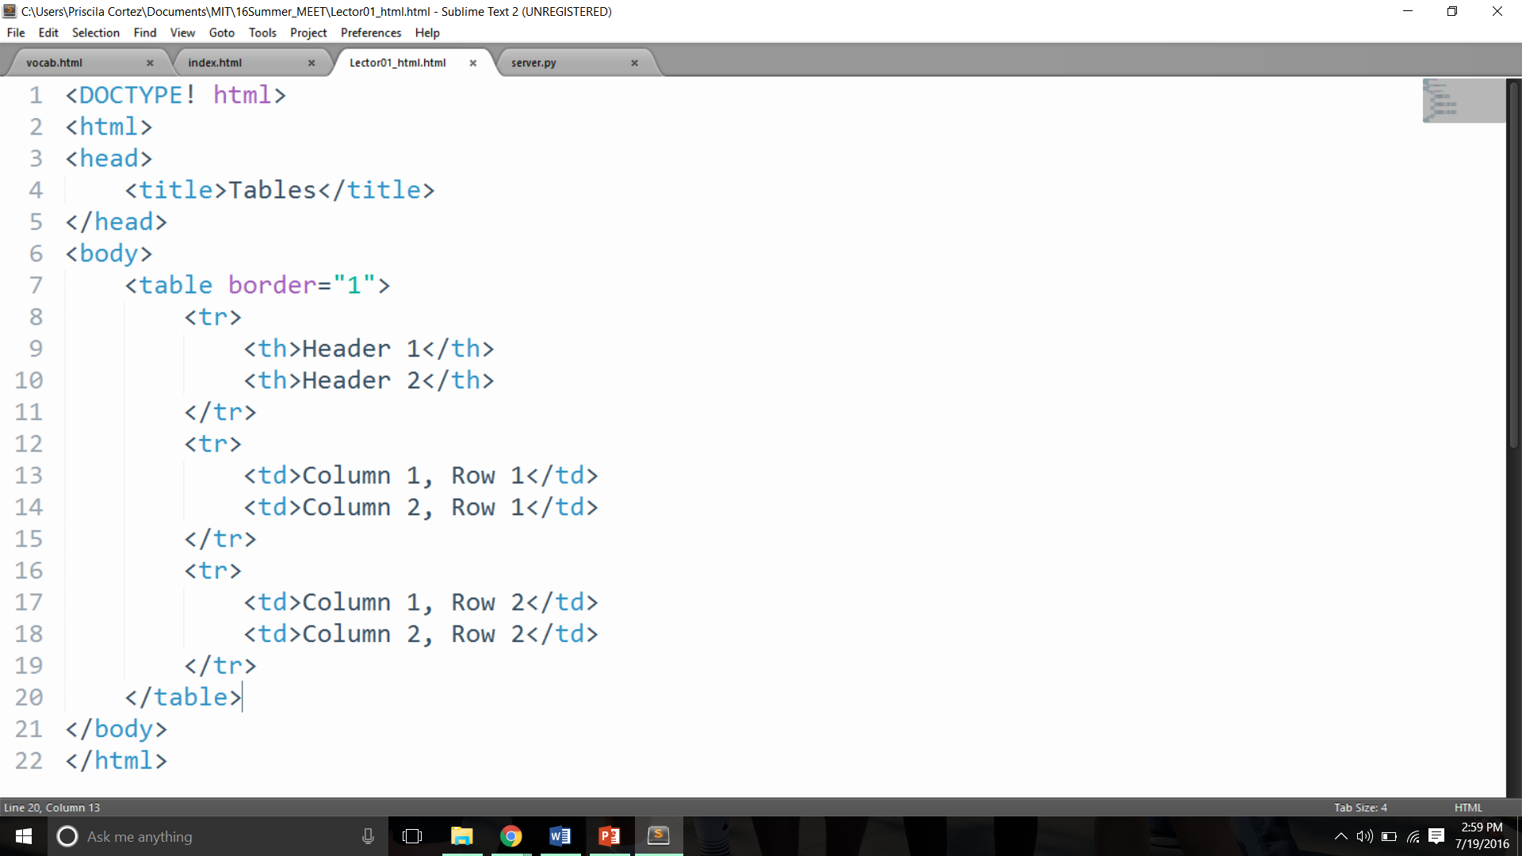
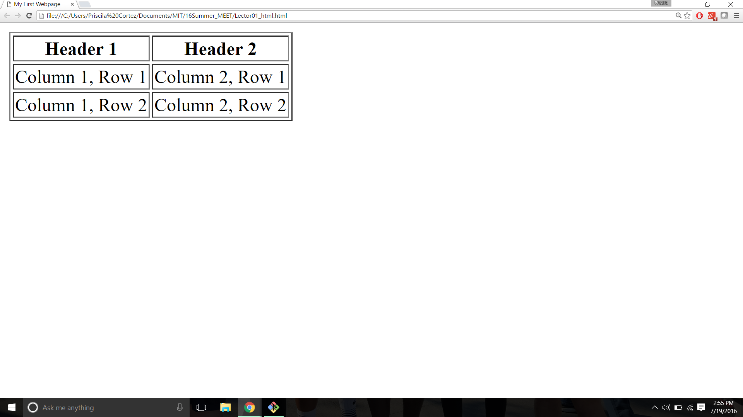
Tables
The <table> tag defines the boundaries of the table
border is an attribute that defines the width of the border in px (pixels)

Slide 10
Tables
<th> defines a table header cell.
The <tr> tag defines a table row.
<td> defines a table data cell

Slide 11
Tables
The <table> tag defines the table. “border” is an attribute that defines the width of the border in px.
The <tr> tag defines a table row.
<th> defines a table header cell.
<td> defines a table data cell

Slide 12
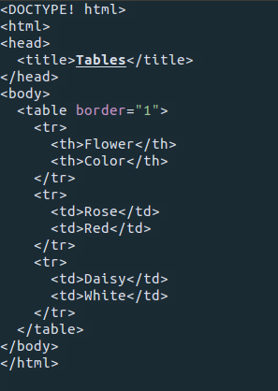
Activity
Read some code:
What table will this make?

Slide 13
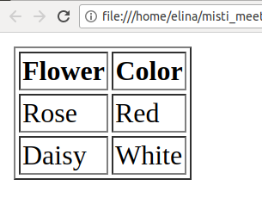
Activity

Slide 14
Lab 3: Tables Lab: go.meet.sh/html-lab Slides: go.meet.sh/html-day2 Cheatsheet: go.meet.sh/html-cheat
Name | Month of Birth | Favorite Food | Favorite Color
Ramesh | April | Hummus | Blue
George | July | Ramen | Blue
Priscila | December | Sushi | Green
Sophia | February | Pizza | Red

Slide 15
Lists

Slide 16
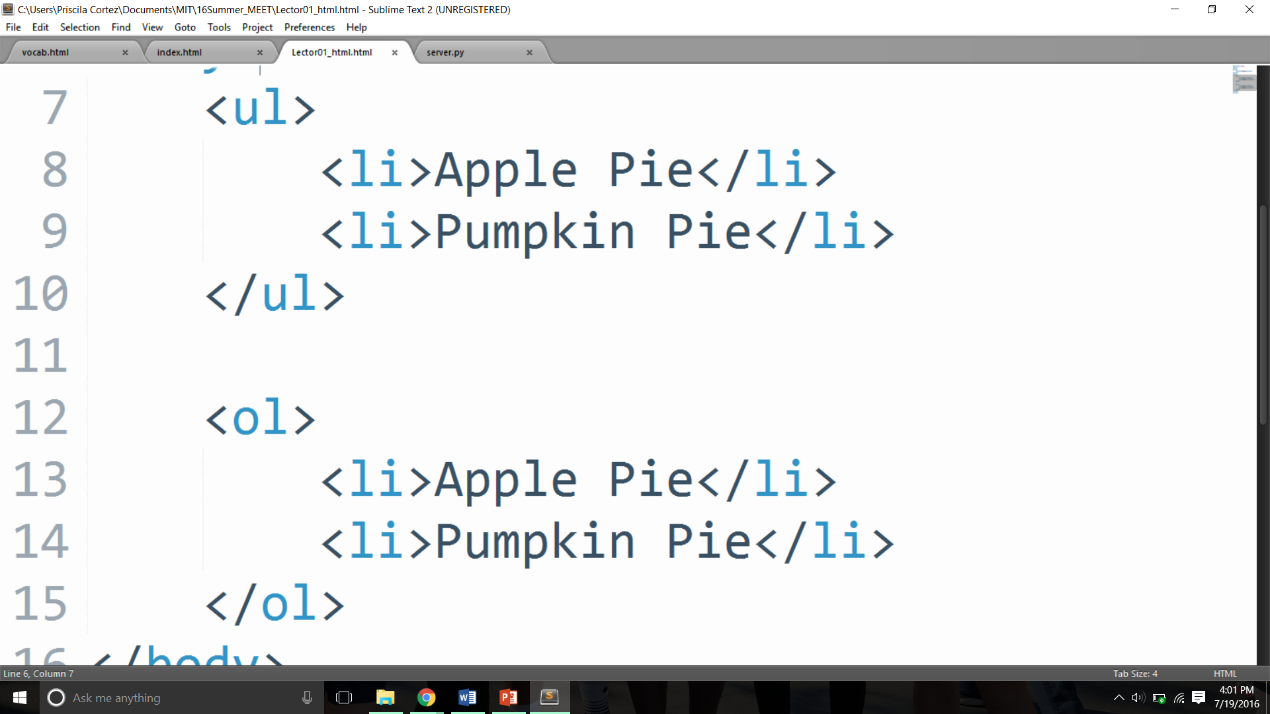
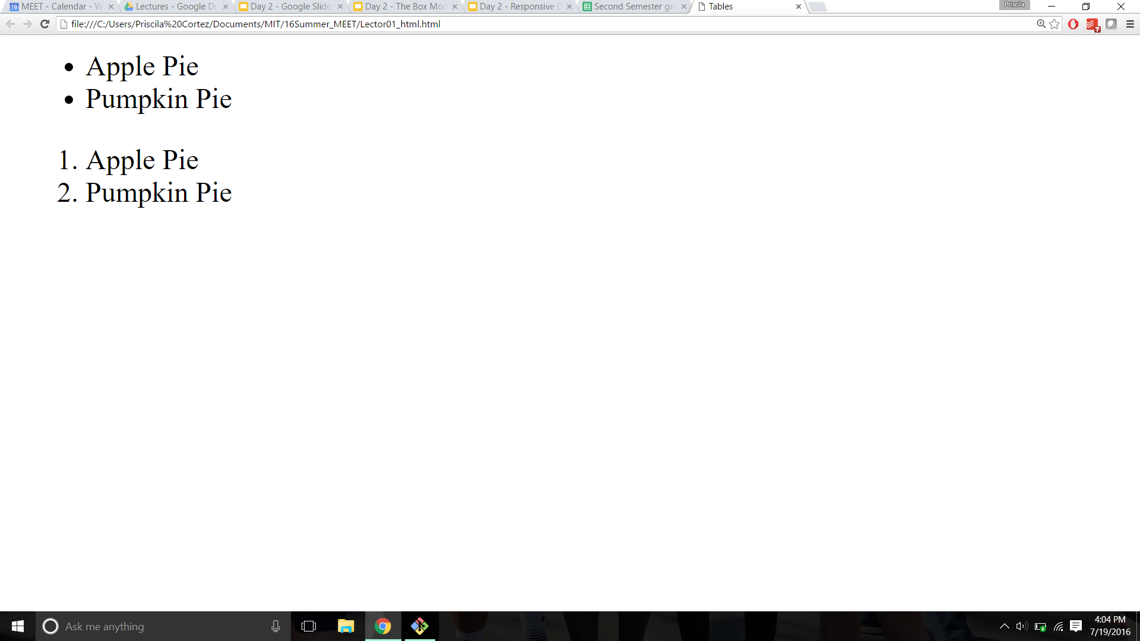
Unordered and Ordered Lists

Slide 17
Lab 4 Lab: go.meet.sh/html-lab Slides: go.meet.sh/html-day2 Cheatsheet: go.meet.sh/html-cheat

Slide 18
Forms

Slide 19
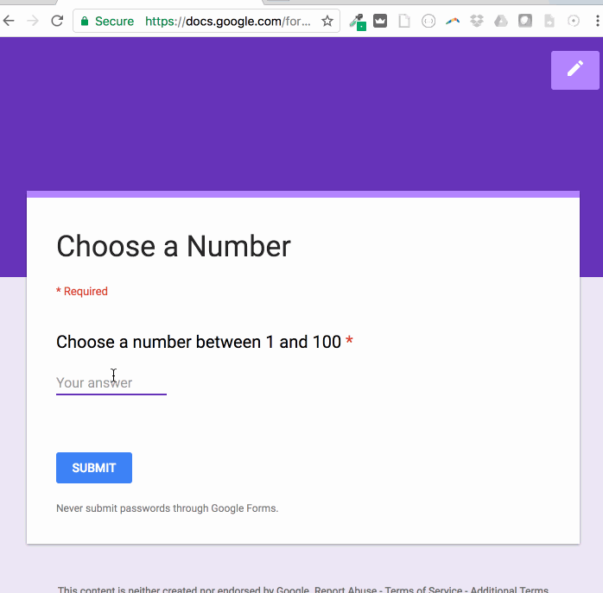
Forms
HTML forms are an easy way to collect user input
Defined by <form> tag
Consists of form elements, such as <input>

Slide 20
<input> tag
<input> has type and name attributes
“name” is the name the input will be submitted as
More important later on
“type” defines how the <input> element is displayed
<input type=”text”> allows the user to enter text
<input type=”password”> blocks what the user enters from sight
<input type=”radio”> allows the user to select one out of a few choices
<input type=”checkbox”> allows the user to select multiple choices
<input type=”submit”> allows the user to submit the form

Slide 21
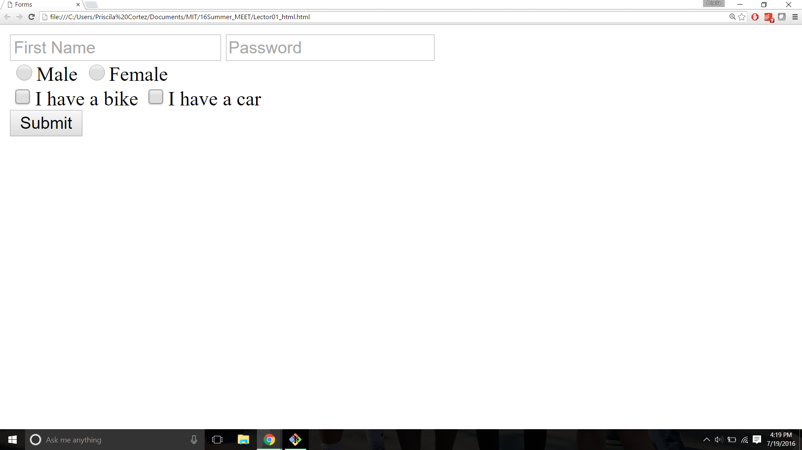

Slide 22
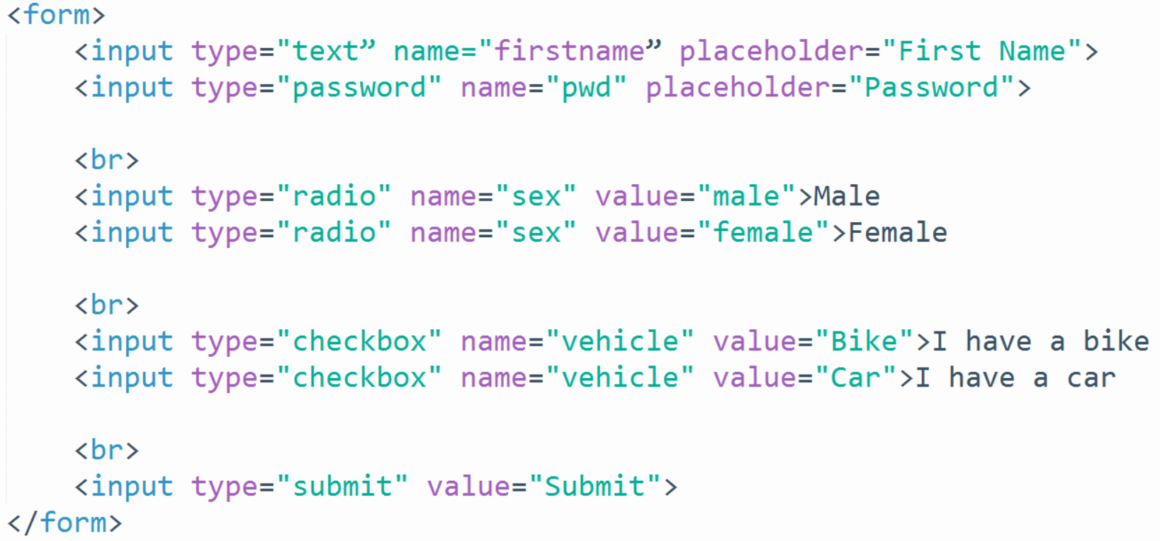

Slide 27
Lab 5 Lab: go.meet.sh/html-lab Slides: go.meet.sh/html-day2 Cheatsheet: go.meet.sh/html-cheat

Slide 28
Div & Page layout

Slide 29
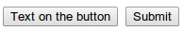
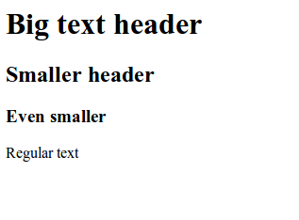
Inline vs Block-Level Elements
“Inline” tags go on the page without starting a new line
<a>, <img>, <input>, etc.
easily put them next to each other
“Block” tags start and end with a new line
<p>, <h1>, <h2>, <ul>, <ol> etc.

Slide 30
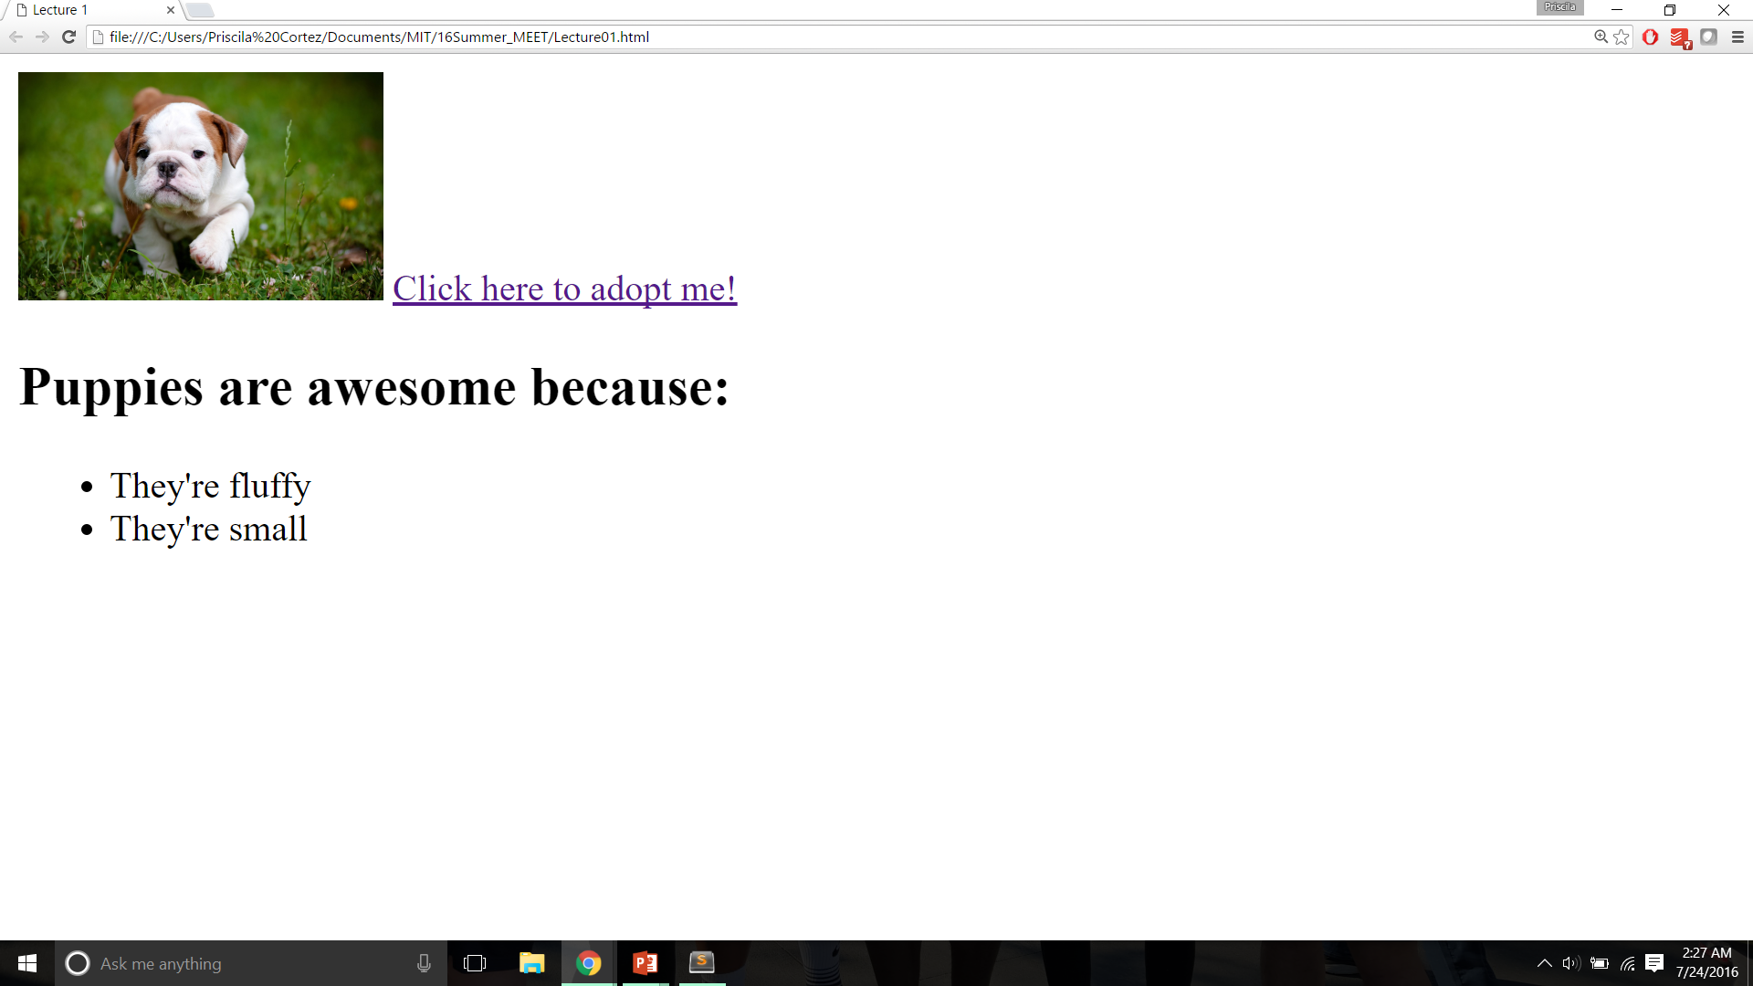

Slide 31
Page Layout and <div>
<div> defines a division or section of an HTML document
It is a block level element, used as a container to group other elements
Can be used to set style for large blocks of content
Gives greater control over document layout
<span> is identical to <div> except that it is an inline element

Slide 32
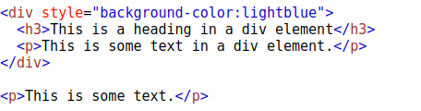
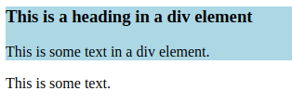
Example

Slide 33
Classes and IDs
Classes and IDs let us name and organize elements
Elements can be given a “class” attribute
<div class=”post”> … </div>
And an “id” attribute
<p id=”first”> … </p>
Classes are for groups, ids are for individual elements
Classes are like families of elements
Ids are like people
(This is important for CSS, which you will see next!)

Slide 34
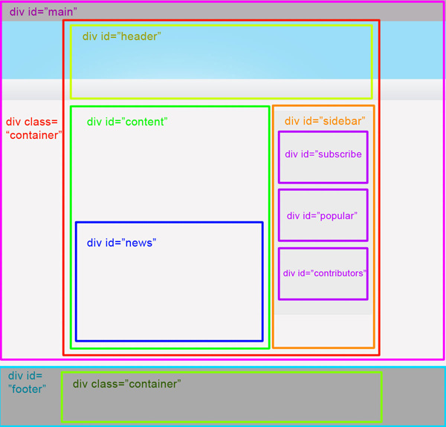
Organize!
Div’s are awesome!
You’ll thank yourself later.

Slide 35
Lab 6 Lab: go.meet.sh/html-lab Slides: go.meet.sh/html-day2 Cheatsheet: go.meet.sh/html-cheat

